Slide 1
What is the Internet?
CPSC 3600

Slide 2
What networking challenges were described in the assigned article?
Notes:
https://developer.oculus.com/blog/networked-physics-in-virtual-reality-networking-a-stack-of-cubes-with-unity-and-physx/

Slide 3
Learning Objectives
Covering Sections 1.1 - 1.3 today
Introduction to terminology and concepts that will be expanded later in the course
Big picture overview of the physical structure of networks

Slide 4
What is the Internet?

Slide 5
What is the Internet?
The hardware, standards, and services required to create a massively interconnected network of devices

Slide 6
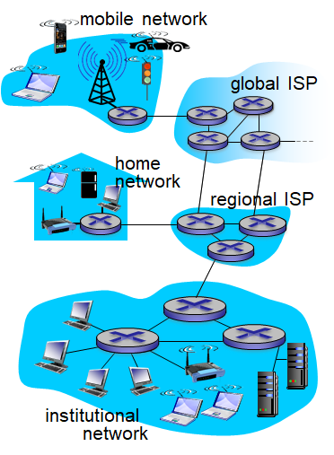
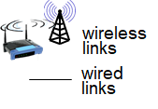
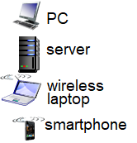

Hardware
End systems/Hosts
PCs, laptops, servers, phones, toasters, ...
Communication links
Fiber, copper, radio, satellite, …
Packet switches + routers
(e.g. traffic lights, street signs, traffic cops, …)

Slide 7
Hardware - Traffic analogy
End systems/Hosts
Houses, stores, warehouses, hospitals, ...
Communication links
Interstates, highways, roads, driveways, ...
Packet switches + routers
Traffic lights, street signs, traffic cops, …
Notes:
Packets are cars carrying people and goods
Hosts and end systems are the places people are, or where they want to be. Edge nodes on the network
Communication links are the connections that allow people to move from one place to another. Just like roads, links have different capacities
Transmission rate/bandwidth → theoretical # of cars per hour → # of lanes * speed limit
Throughput ~ actual # of cars per hour → bandwidth + reality (jams, crashes, etc)
Driveway is like your connection to your ISP, it’s what provides you with initial access to the road network
Just like roads all over the earth, most parts of the Internet are interconnected to each other
The “darknet” is just parts of the internet that are more difficult to access (e.g. require off roading to get to)
Packet switches and routers are the infrastructure that connects roads together and helps drivers figure out what path to take

Slide 8
Standards
Need standards to facilitate communication between interconnected devices
E.g. Drive on the right side of the road, stop at red octagons, …
Many different protocols control sending and receiving of different messages
TCP, IP, HTTP, Skype, 802.11, …
Defined by different entities IETF and RFC
IETF: Internet Engineering Task Force
RFC: Request for comments

Slide 9
Protocols
Protocols define:
The format of a message
The order of messages sent and received
The actions taken on transmitting or receiving a message
All communication on the Internet is governed by protocols
Transmission Control Protocol (TCP)
Protocol to enable reliable communication between end systems
Internet Protocol (IP)
Protocol to communicate between routers and end systems

Slide 10
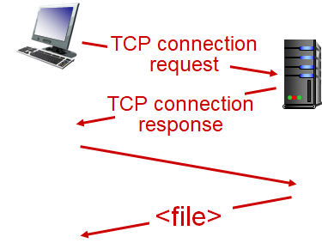
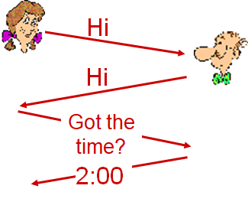
Protocols
Human Protocol Computer Protocol

Slide 11
Services
Infrastructure that provides services to applications
The Web, VoIP, email, games, e-commerce, …
Provides programming interface to applications
Hooks that allow sending and receiving to other programs
Provides services, analogous to postal service forwarding

Slide 12
Class Activity (~5 minutes)
Pair up with a neighbor and explain the role of Hardware, Standards/Protocols, and Services with regard to the Internet, and how they can be fit into the traffic analogy

Slide 13
Network Edge and Core
The types of hardware used in the Internet map onto another way of describing it
The Edge: clients, servers (places where apps and data are)
The Core: interconnected routers

Slide 14
Network Edge
Essentially any device you use is an Edge device
End systems, hosts
Edge router is the first router an edge device
Many ways to connect to an edge router
Residential access nets
Institutional access networks (school, company)
Mobile access networks
Differences?
Bandwidth, shared/dedicated, download/upload, ...

Slide 15
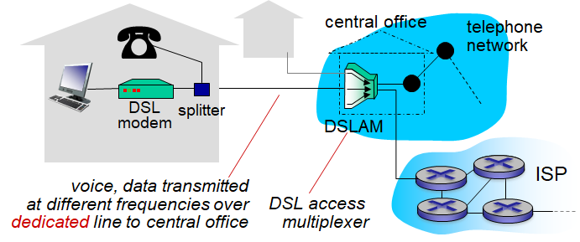
Home Access: DSL (Digital Subscriber Line)
Shares existing phone line, voice split from data
< 24 Mbps download, < 2.5 Mbps upload (asymmetric)

Slide 16
Home Access: DSL (Digital Subscriber Line)
Shares a single line by using different frequencies for different types of data
High-speed download in 50 kHz to 1 MHz band
Medium-speed upload in 4 kHz to 50 kHz band
Voice in 0 to 4 kHz band
DSL design for 5 to 10 mile connections to central office
Distance affects transmission over physical medium used (twisted-pair cables)

Slide 17
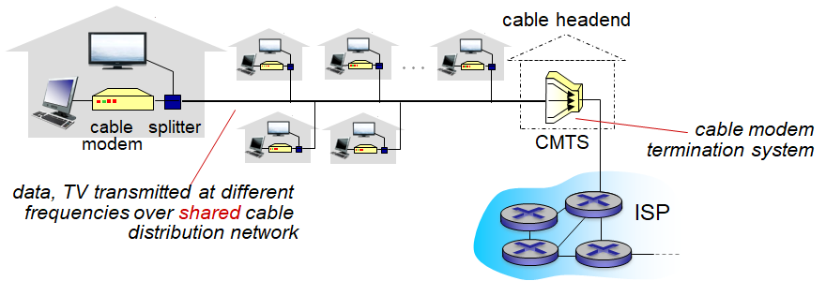
Home Access: Cable
Uses existing cable TV infrastructure
< 100 Mbps download, < 10 Mbps upload (asymmetric)
Transmission medium: hybrid fiber coax (HFC)

Slide 18
Home Access: Cable
Shared cables between homes connecting to cable head end, unlike DSL which has dedicated lines
Every packet sent by head end travels to every connected home
Activity of other homes can affect your bandwidth

Slide 19
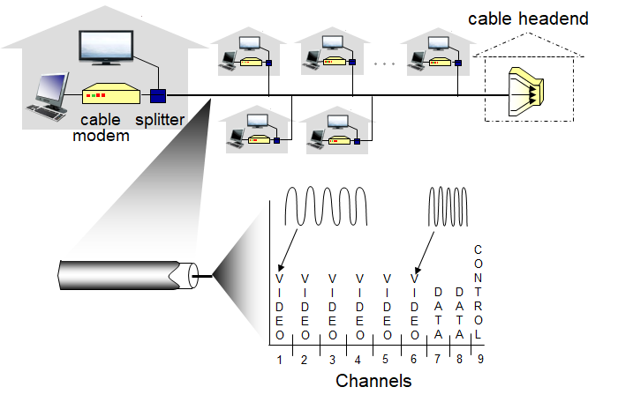
Home Access: Cable
Accomplished via frequency division multiplexing

Slide 20
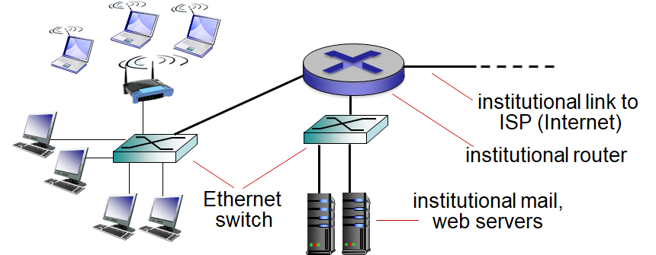
Enterprise Access: LAN (Local Area Network)
More devices than home systems, greater internal complexity for the institutional network
Supports very high transmission rates (10 Gbps+)

Slide 21
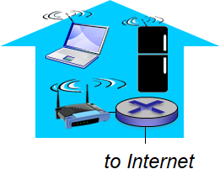
Home/Enterprise Access: WiFi
Shared wireless access network connects end system to router (potentially via an access point / base station)
Wireless LAN
Range of ~100ft
802.1 b/g/n/ac protocols, different transmission rates
11 Mbps, 54 Mbps, 450 Mbps, 1.3 Gbps
WiFi cards, routers support specific set of protocols

Slide 22
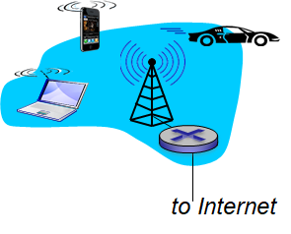
Wide-area Wireless
Different technology for wide-area networks (e.g. phones)
Range of 10+ km from cellular tower
Transmission speeds between 1 and 10 Mbps
Different protocols
3G, 4G, 4G LTE, ...

Slide 23
Physical Media
Several different types of “physical media” used to establish network connections
Twisted-pair copper wire
Coaxial cable
Fiber optics
Radio (Terrestrial/Satellite)

Slide 24
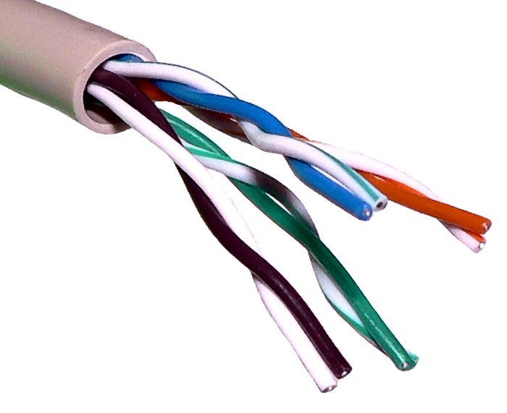
Twisted-pair Copper Wire
Least expensive, most commonly used medium
Two insulated copper wires twisted around each other
Twisting reduces electrical interference from other nearby pairs
Many pairs can be twisted together into a single cable
Data rates range between 10 Mbps and 10 Gbps
Length of cable negatively affects data rate
Cables can be 100+ feet long
Ethernet cables are twisted-pair cables

Slide 25
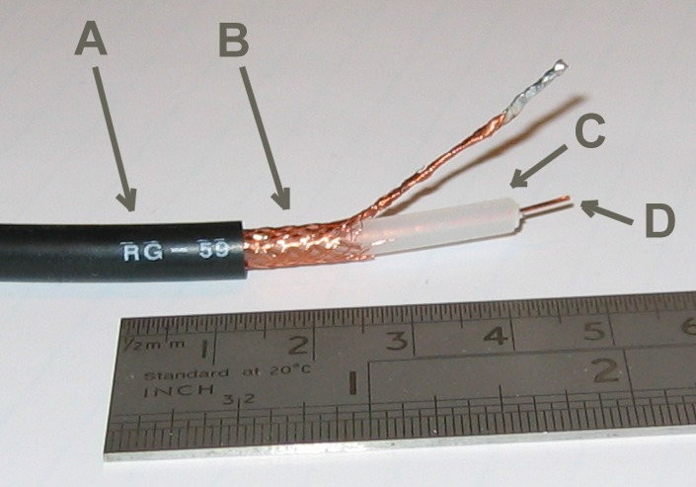
Coaxial Cable
Two copper wires, but not twisted. Instead, one is inside of the other, separated by insulation
Commonly used for cable connections
Carry multiple signals simultaneously on different frequencies

Slide 26
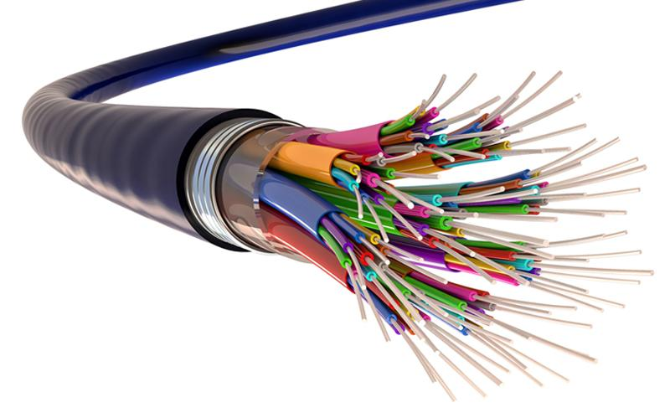
Fiber Optics
Glass fiber carries light pulses, each one a bit of data
Light constrained by total internal reflections
High-speed transmission (10 Gbps to 10+ Tbps)
Travels at speed of light in glass (~200,000 km/s)
Low error rates
Immune to electromagnetic noise
Very low signal attenuation (up to 100 km)
Higher cost (including infrastructure)
E.g. transmitters, switches, receivers, ...

Slide 27
Radio
“Unguided” medium, signal carried in electromagnetic spectrum
Potential issues include reflection, interference, obstruction
Terrestrial microwave (45 Mbps channel)
WiFi (11 Mbps to 1.3 Gbps+)
Wide-area cellular (10+ Gpbs)
Satellite (kbps to 45 Mbps channel, high latency)
Geostationary vs. low orbit (vs. interplanetary)

Slide 28
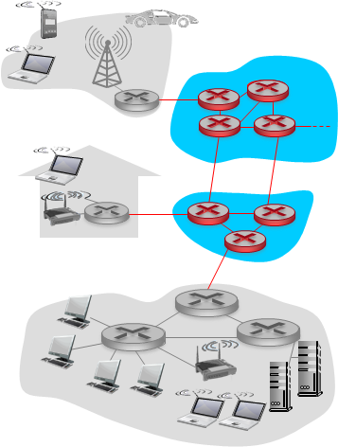
The Network Core
Mesh of interconnected routers
Packet-switched network
Hosts break data into individual packets
Routers forward packets to next router along way to destination, till destination

Slide 29
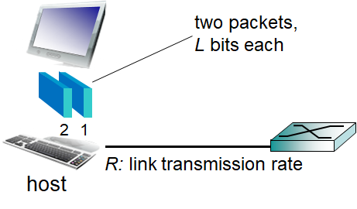
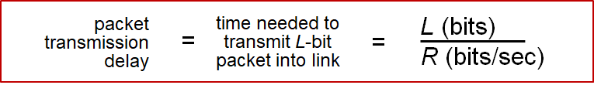
Host: Send Packets of Data
Application creates message
Message broken into packets of length L bits
Transmitted into the network at transmission rate R
The link capacity, aka bandwidth

Slide 30
Terminology
Mbps vs. MBps
Lowercase b = bits
Uppercase B = bytes
8 Mbps = 1 MBps
For this course, we will assume
1 Kb = 1000 bits
1 Mb = 1000 Kb
1 Gb = 1000 Mb
...

Slide 31
Packet Switching: Store and Forward
Packet switch waits till it has received the whole packet to begin sending to the next destination
Why?
Two important implications
Adds to transmission latency
Have to store packets as they come in (memory buffer)

Slide 32
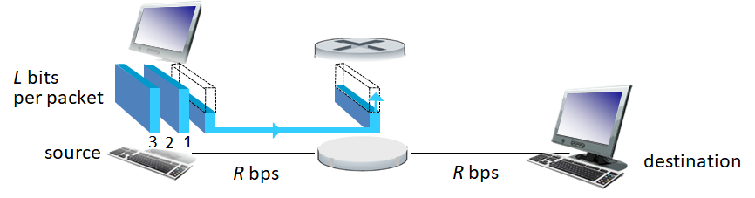
Ignoring propagation delay, how long does it take for packet 1 to get to the destination?
1 L/R
2 L/R
3 L/R
4 L/R

Slide 33
Ignoring propagation delay, how long does it take for packet 3 to get to the destination?
1 L/R
2 L/R
3 L/R
4 L/R

Slide 34
Ignoring propagation delay, how long does it take for packet 1 to get to the destination if we have N total links?
1 L/R
N * L/R
2N * L/R
N² * L/R

Slide 35
Ignoring propagation delay, how long does it take for packet 3 to get to the destination if we have N total links?
N * L/R + 0 L/R
N * L/R + 1 L/R
N * L/R + 2 L/R
N * L/R + 3 L/R

Slide 36
Packet Switching: Store and Forward
General solution for transmission time
P packets of L bytes
N routers with transmission rate R

Slide 37
Packet Switching: Store and Forward
General solution for transmission time
P packets of L bytes
N links with transmission rate R
Transmission delay = N*L/R + (P-1)*L/R

Slide 38
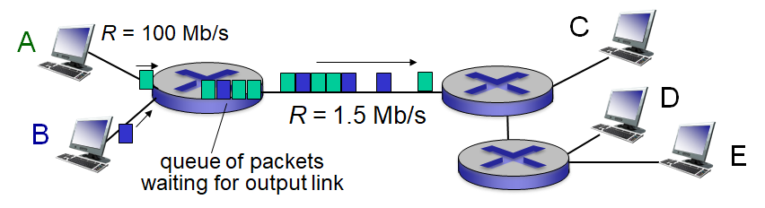
Packet Switching: Queuing delay, loss
If the arrival bit rate exceeds the transmission rate, then we have to buffer packets
Adds latency as packets wait in the queue
Packets can be dropped (lost) if the memory buffer fills up

Slide 39
Packet Switching: Routing Packets
In a packet switched network, the router has to decide which is the next router it should send a packet to
Routing: determines source-destination route taken by packets
Routing can be done differently in different systems

Slide 40
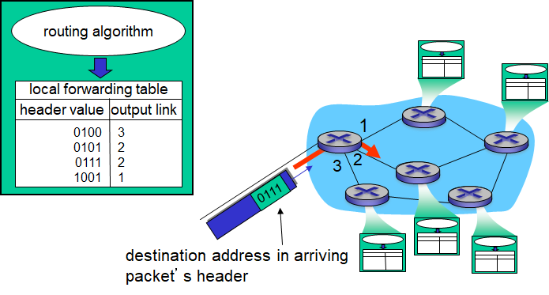
Packet Switching: IP Routing
The Internet uses IP addresses for routing
E.g. 104.62.113.162, or 192.168.1.12
Routers contain forwarding tables that map different outbound links to different destination addresses
Notes:
www.traceroute.org

Slide 41
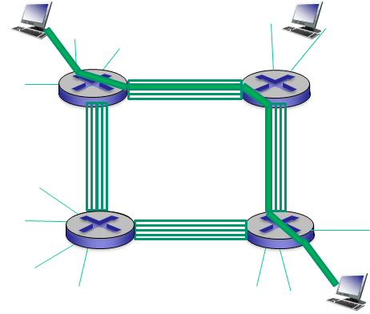
Circuit Switching
Alternative to packet switching
Reserves an end-to-end pipeline between source and destination
No sharing with other users
Ensures you get full access
Resources will be wasted when you are idle
Used for traditional telephone networks

Slide 42
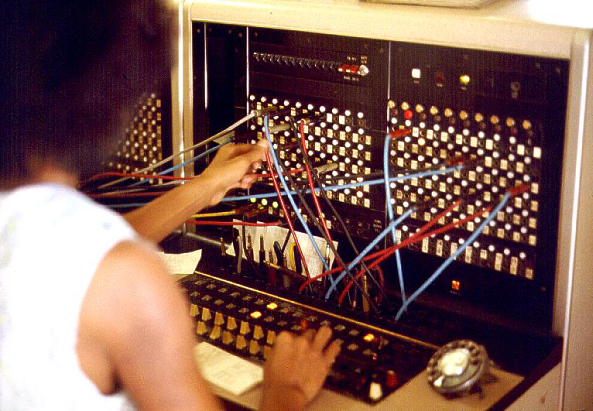

Slide 43
Circuit Switching: Multiplexing
In practice, doesn’t need dedicated hardware, just dedicated resources
Two options
Frequency domain multiplexing (e.g. radio stations)
Time domain multiplexing

Slide 44
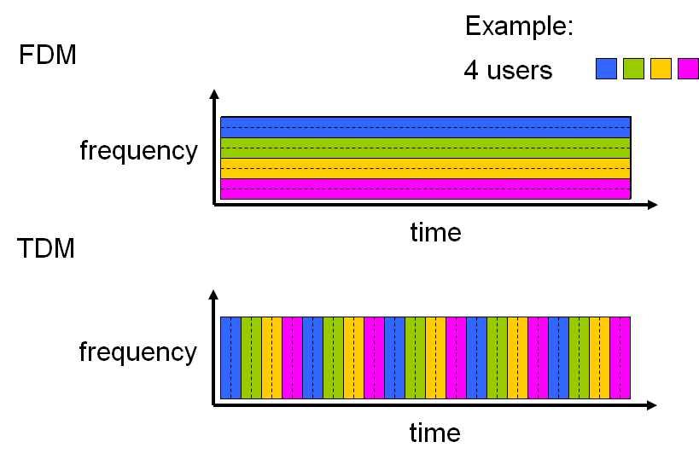

Slide 45
Packet Switching vs. Circuit Switching
Each have advantages, disadvantages, however most systems today use packet switching
Under most circumstances, packet switching will result in better utilization of resources by more users

Slide 46
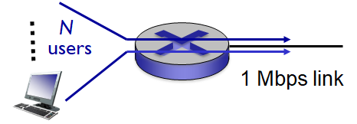
Assume each user
Uses 100 kb/s when “active”
Active for 10% of the time

Slide 47
Assume each user
Uses 100 kb/s when “active”
Active for 10% of the time
How many users can circuit switching support?

Slide 48
Assume each user
Uses 100 kb/s when “active”
Active for 10% of the time
How many users can circuit switching support?
What is the average utilization of the link?

Slide 49
Assume each user
Uses 100 kb/s when “active”
Active for 10% of the time
How many users can packet switching support?
No simple answer, probabilistic
Can compute using binomial distribution

Slide 50
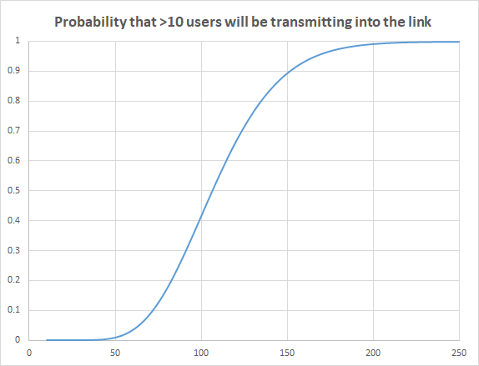
Easily supports 35 users
p_{>10 users} = 0.0004
p_{<10 users} = 0.9982

Slide 51
Easily supports 35 users
p_{>10 users} = 0.0004
p_{<10 users} = 0.9982
What happens during the 0.04% of the time when > 10 users are active simultaneously?

Slide 52
What happens if we have 150 users?
p>10 users = 0.8986
p<10 users = 0.0600
What effect will this have on the buffer?

Slide 53
Packet Switching vs. Circuit Switching
Packet switching is great for bursty data, where users aren’t constantly transmitting
Easier to share resources
No need to setup/tear down a circuit
Possible to get excessive congestion that prevents anyone from using the network
Need protocols to handle congestion, ensure reliable data transmission
Unsolved problem how to guarantee bandwidth for audio/video apps using packet switched networks

Slide 54
Structure of the Internet
The internet is a network of networks (of networks...)
End systems connect to Internet via an access ISP (internet service provider)
Access ISPs have to be interconnected to enable communication
Resulting networks evolved organically over time, driven by economics and national policies

Slide 55
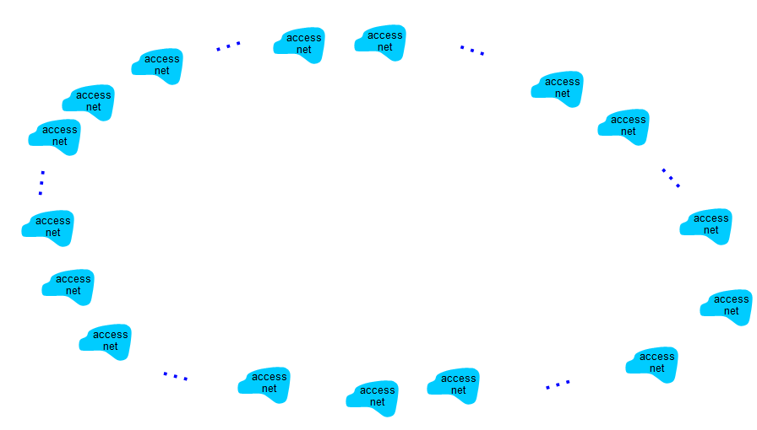
Given millions of access ISPs, how do you connect them?

Slide 56
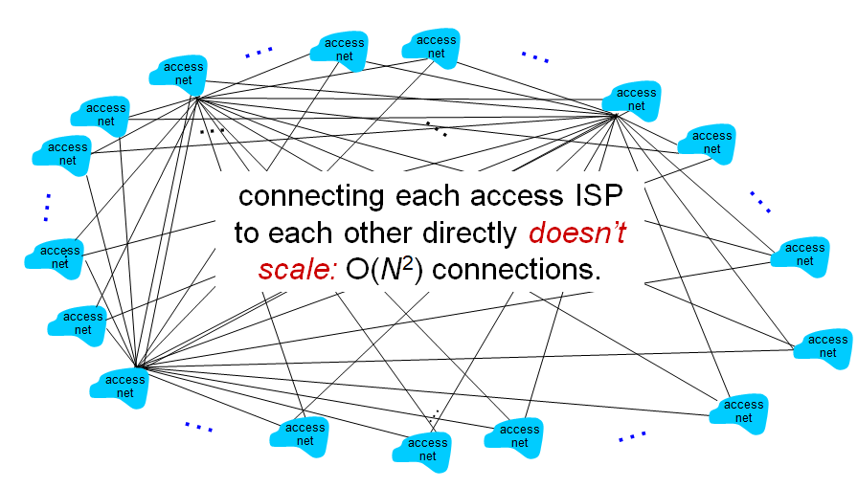
Fully interconnected??

Slide 57
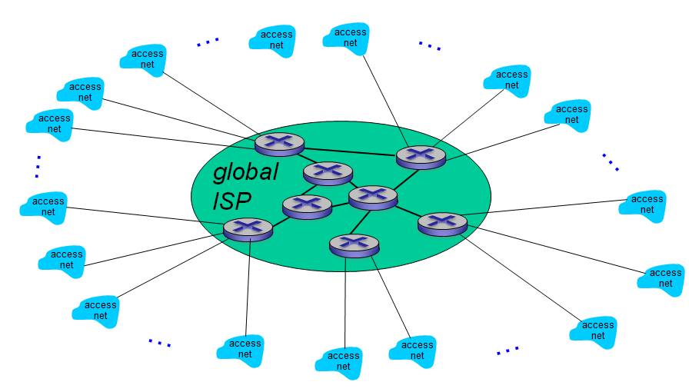
Connect through one global ISP?

Slide 58
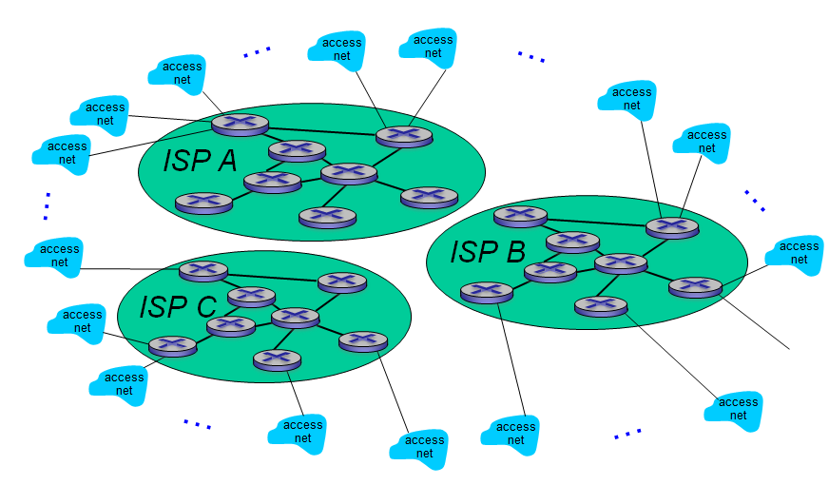
If one global ISP is a viable business, there will be competition

Slide 59
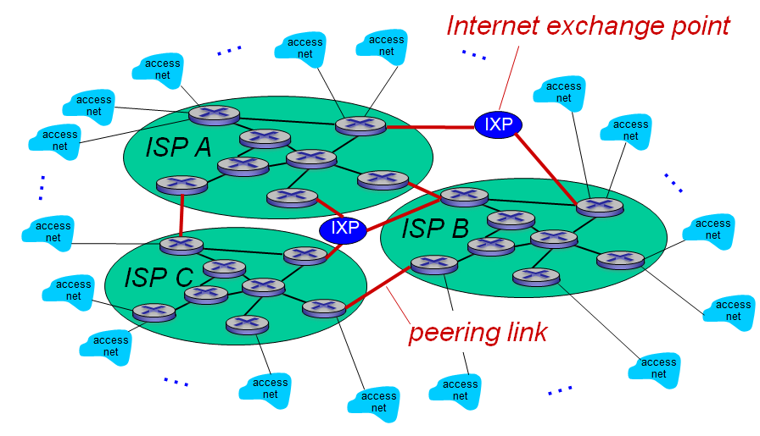
So we need to connect the global ISPs

Slide 60
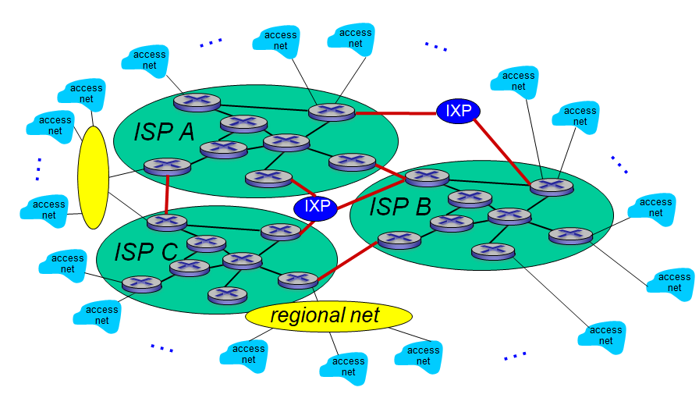
Regional networks may arise to connect access nets to ISPs

Slide 61
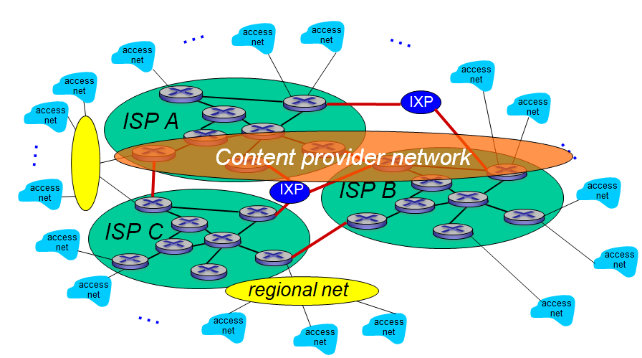
Major content providers may run their own networks to bring services close to users

Slide 62
Before Next Class
Read Sections 1.4 (including all sub-sections)
Complete 3 of the following problems
R1, R3, R5, R8, R11, R14
Random students will be asked to share your answers to these problems at the start of the next class

